Slide 1
Zero-day Attacks and Countermeasures
Analysis Based on Corporal and Social Impact.
Presented by:
Mohammed Al-Badr
Sultan Al-Boinin
Sultan Al-Emadi
Ali Al-Anzi

Slide 2
Table of Content
Introduction
Impact:
Negative
Positive (Preventions)
Confidentiality and Phishing
Countermeasures
Future Research Track
Conclusion

Slide 3

Introduction
Zero-day attack : is one which takes advantage of a previously undiscovered vulnerability in a software program on "day 0" of the vulnerability's identification.
Goal : is to obtain unauthorized access to a computer system or to pose a danger to one that is already functioning.
zero-day vulnerabilities are regarded the most dangerous threat to computer enterprises

Slide 4
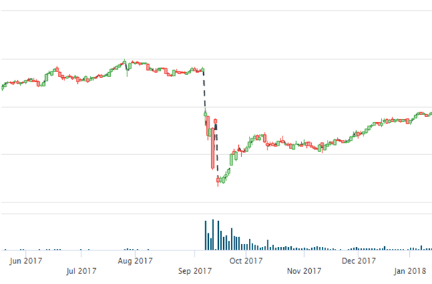
Impact
mx growth
Positives and Negatives
Figure 1: Stock price of Equifax from June 2017 to June 2018 (Obtained from Investor.Equifax.com

Slide 5

Negative Impact:
Data Theft
Unauthorized Control and Access.
Reputation Damage
Financial Loss

Slide 6
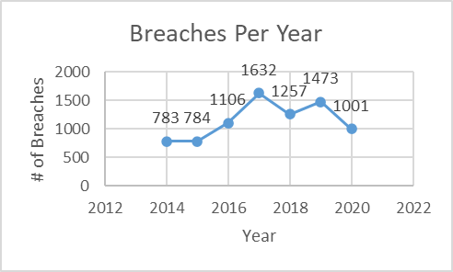
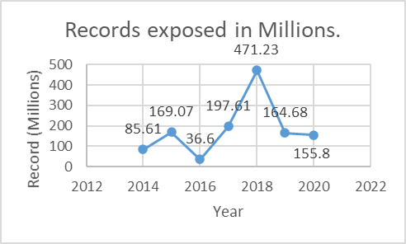
Data Theft
Zoom pre-COVID19 Updates
Equifax 2017 Data Breach
Figure 2: Data breaches from 2014 to 2020 (Obtained from Statista.com)
Figure 3: Leaked data records in millions (Obtained from Statista.com)

Slide 7
Financial Loss
Equifax 2017 Data Breach
Stuxnet (Iran’s Nuclear Program)
WannaCry Cryptocurrency Ransom
Figure 4: Stock price of Equifax from June 2017 to June 2018 (Obtained from Investor.Equifax.com

Slide 8

Positive Impact (Preventions):
Patch Management
Backup Plans
Cybersecurity teams

Slide 9
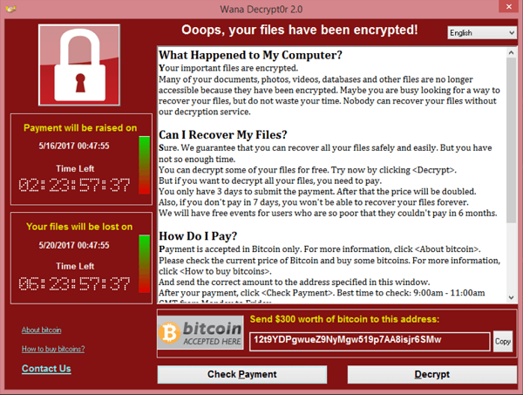
Patch Management
Microsoft Countermeasure to WannaCry Ransomware
Figure 5: WannaCry ransonware window (Obtained from Wikipidea.com)

Slide 10
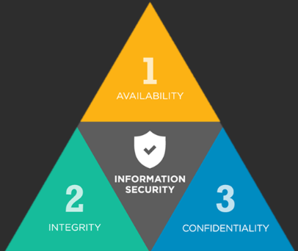
Confidentiality
Confidentiality is about keeping data and private information a secret that can only be exposed to authorized people.
The zero-day attacks aim to access data without having authorization.
done by finding an exploit in the system or by some help from entities that have access.

Slide 11
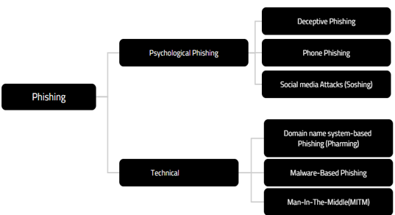
Zero-day Attacks Types

Slide 12
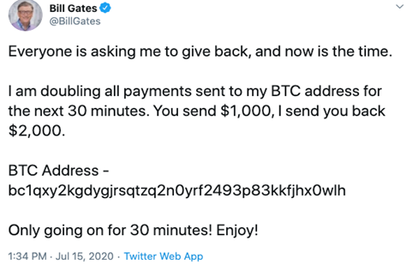
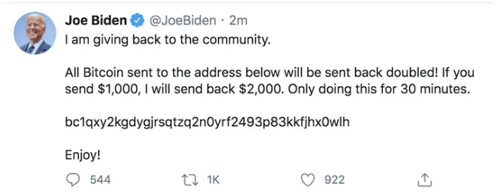
Psychological Phishing
Email Phishing
Phone Phishing
Social media attacks (Soshing)
Pros:-
Easy
Very effective

Slide 13
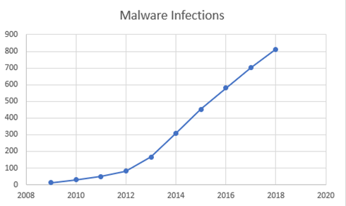
Technical Attacks
Malware-Based Phishing
Man-In-The-Middle
Domain name system-based (Pharming)

Slide 14
Countermeasures
There is yet to be a definitive way to counter measure zero-day attacks!
But there are some solutions that helps with mitigating the damage.
Machine learning mitigation
1.collecting a sample of a well-known malware that will be analyzed and studied.
2.correlation algorithm that correlates the relationships between the malware that we analyzed and studied to be able to predict future variants.
3.use a malware detection method to detect the malware that’s been predicted
Human Awareness
Legislations

Slide 15
Future Research Track
An open-source project will propose a set of models that could be used for zero-day attack detection using machine learning techniques
There will be study on the impact of malwares size, RAM and processor speed on analysis time
There is a plan to search for use of software defining network (SDN) for the detection and mitigation of cyber-attacks, SDN a new programmable network model that separates the control and data planes keep an eye on the whole network and implement policy decisions

Slide 16
Conclusion
Zero-day attack could be useful for
knowing methods used to hack the system and know where the vulnerability is then fix it.
increases the awareness of cyber security team to avoid having the system compromised by hackers.
having back up plans.
Phishing became common by targeting people who work in an effective place and get the hacker unauthorized access to data.
Zero-day attack are illegal and harm many organizations, but they may be useful in rising security awareness.

Slide 17
Thanks for listening!
Questions?

